Slide 1
Chapter 8 Review
CHANGES ON EARTH

Slide 2
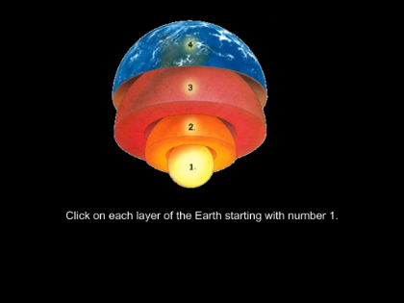
Which layer of Earth is below the crust?
A. Core
B. Crust
C. Mantle
D. Inner core

Slide 3
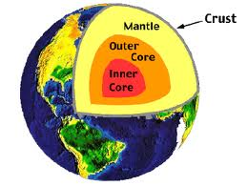
C. Mantle

Slide 4
What forms when water slows enough to fill an area?
Lake
River
Waterfall
Stream

Slide 5
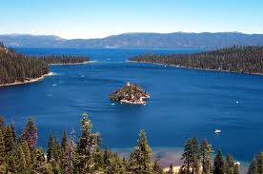
A. lake

Slide 6
What landform is made when a river slowly cuts through rock?
Hill
Plain
Valley
Mountain

Slide 7
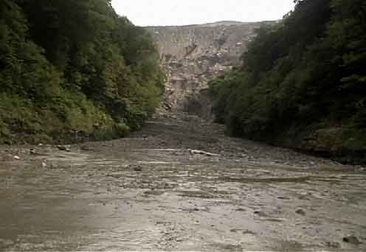
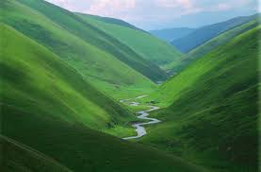
C. valley

Slide 8
What force can rapidly change the Earth’s landscape?
Wind erosion
Weathering
Thunderstorm
Volcanic eruptions

Slide 9
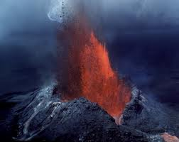
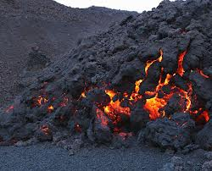
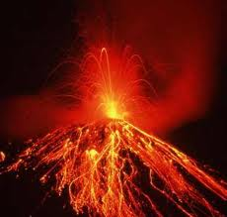
D. Volcanic Eruptions

Slide 10
When igneous rock from a volcanic eruption cools, what does it form?
new core
new crust
new mantle
new inner core

Slide 11
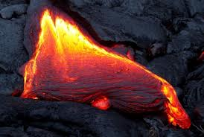
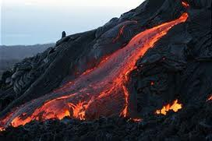
B. new crust

Slide 12
How does water break apart rock?
It takes up less space when it freezes in cold weather.
It takes up less space when it melts in warm weather.
It takes up more space when it freezes in cold weather.
It takes up more space when it melts in warm weather.

Slide 13
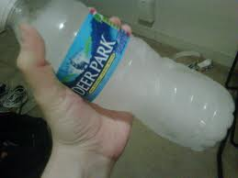
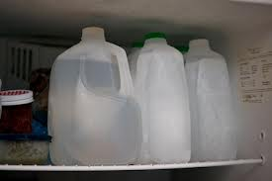
C. It takes up more space when it freezes in cold weather.

Slide 14
What carries soil away from hilly farm fields?
rain
plants
rivers
waves

Slide 15
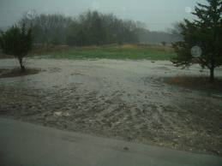
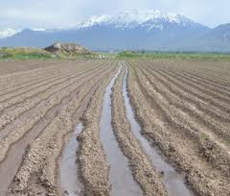
rain

Slide 16
What causes a rockslide-the quick movement of rocks down a slope?
wind
water
gravity
glaciers

Slide 17
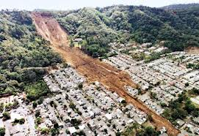
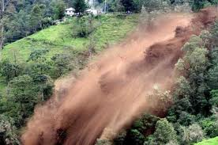
gravity

Slide 18
How does erosion mainly occur in dry regions?
Gravity pulls soil downhill.
Mud flows quickly down a slope.
Sand particles blow against rocks.
Rock particles are carried away by water.

Slide 19
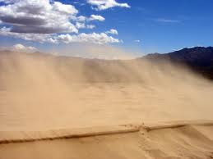
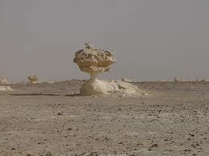
Sand particles blow against rocks.

Slide 20
What is the force of breaking rocks into smaller and smaller pieces?
erosion
gravity
flooding
weathering

Slide 21
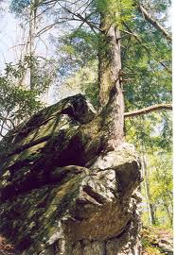
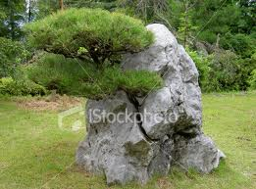
D. weathering

Slide 22
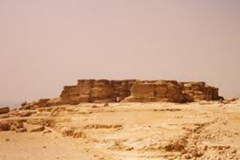
What landform is this?
mountain
glacier
plateau
coast

Slide 23
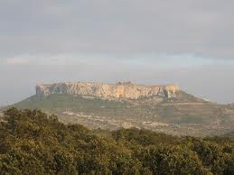
C. plateau

Slide 24
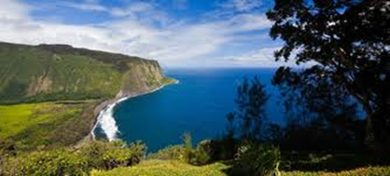
A. coast
B. crust
C. mountain
D. lake
What landform is this?

Slide 25
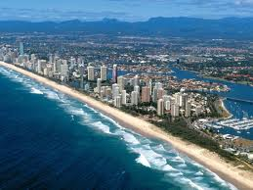
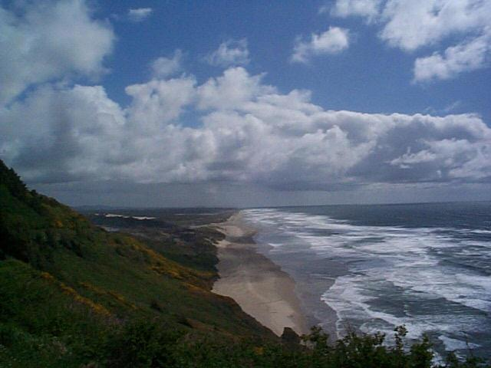
A. coast

Slide 26
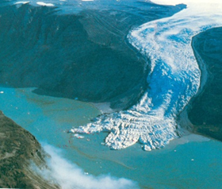
What landform is this?
plateau
coast
lake
glacier

Slide 27
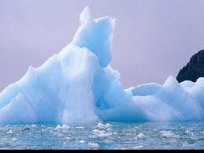
D. glacier

Slide 28
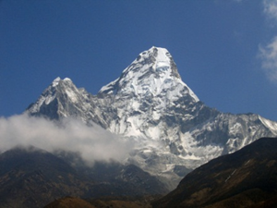
What landform is this?
glacier
lake
mountain
coast

Slide 29
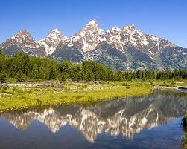
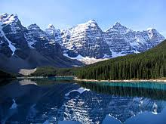
C. mountains

Slide 30
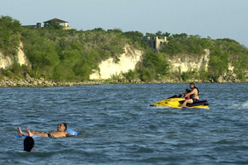
What is this?
plateau
lake
coast
mountain

Slide 31
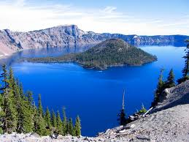
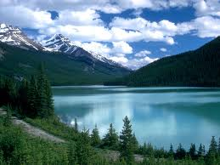
B. lake

Slide 32
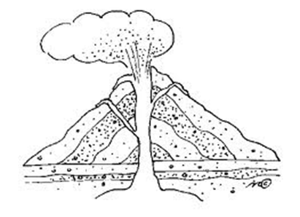
What is this?
magma
lava

Slide 33
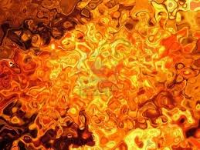
A. magma

Slide 34
What is this?
magma
lava

Slide 35
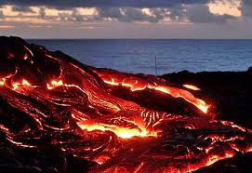
B. lava

Slide 36
Be sure to study!
Good Luck!

